Slide 1
Time management

Slide 2
agenda
Introduction
Set Goals
Prioritize Tasks
Create a Schedule
Minimize Distractions
Reflect and Evaluate

Slide 3
introduction
What is time management?
The coordination of tasks and activities to maximize the effectiveness of an individual’s efforts.
Purpose:
To enable people to get more and better work done in less time. Work smarter, not harder, to get more done in less time.

Slide 4

Set goals
  Set clear short-term and long-term goals to provide direction and purpose to your efforts
  Define what you want to achieve with those goals
  Put your goals in writing with the start date and a tentative deadline

Slide 5
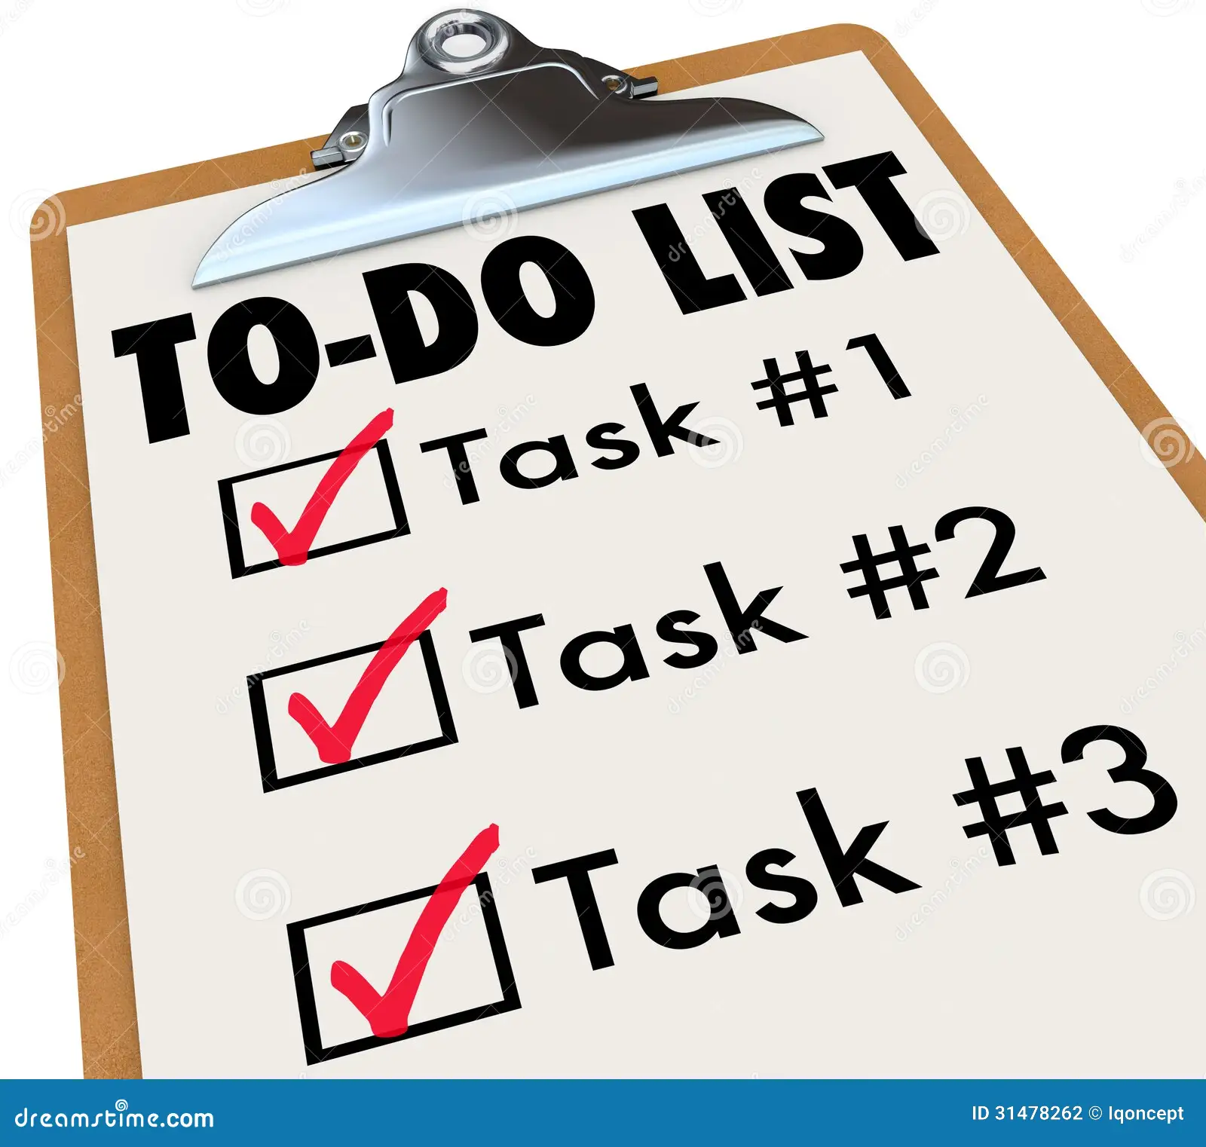
Prioritize tasks
  Organize tasks based on their importance and urgency
  Make a checklist of tasks and check off the boxes as each one is done
  Group similar tasks together and tackle them in batches
  Focus on one task at a time to eliminate overloading

Slide 6
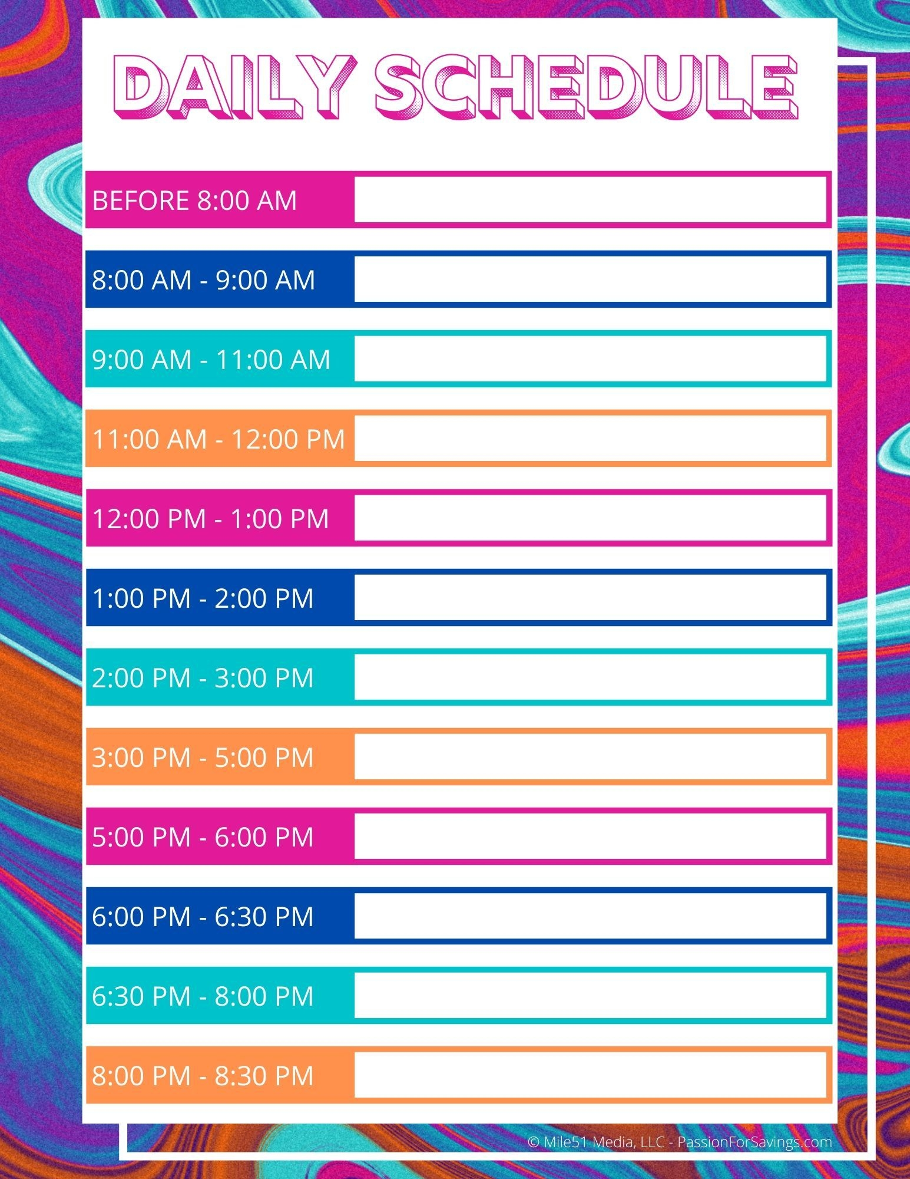
Create a schedule
  Establish a daily, weekly, and monthly schedule that outlines your school commitments, work commitments, and personal time
  Set realistic deadlines and allow for flexibility in your schedule
  Work in 25-minute intervals followed by 5-minute breaks making sure to plan for downtimes to relax

Slide 7

Minimize distractions
  Create a clutter-free workspace
  Turn off notifications and disconnect from technology
  Set boundaries with friends and family

Slide 8

Reflect and evaluate
  Regularly review your time management strategies to identify areas of strength and weakness
  Adjust your schedule and routine as necessary
  Learn from your patterns to determine most and least productive times
  Say no to commitments that do not align with your goals

Slide 9

Questions?

Slide 10

Thank you!
QCC Mentoring
Director: Kalan Lewis
mentoring@qcc.mass.edu
508-854-7409

