Slide 1
Culturally and Linguistically Responsive Pedagogy: An Intercultural Approach to Support Community College Students.
Déborah L. González
Ph.D.
Teresa Varriale González

Slide 2
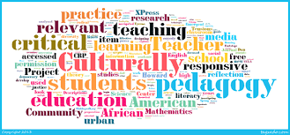
Overview
This presentation will focus on Culturally and Linguistically Responsive Pedagogy, including translanguaging, as a strategy to support the needs of bilingual and multilingual students, as well as English Learners.

Slide 3
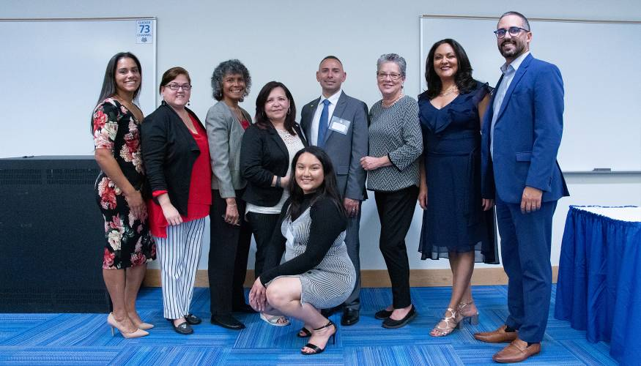
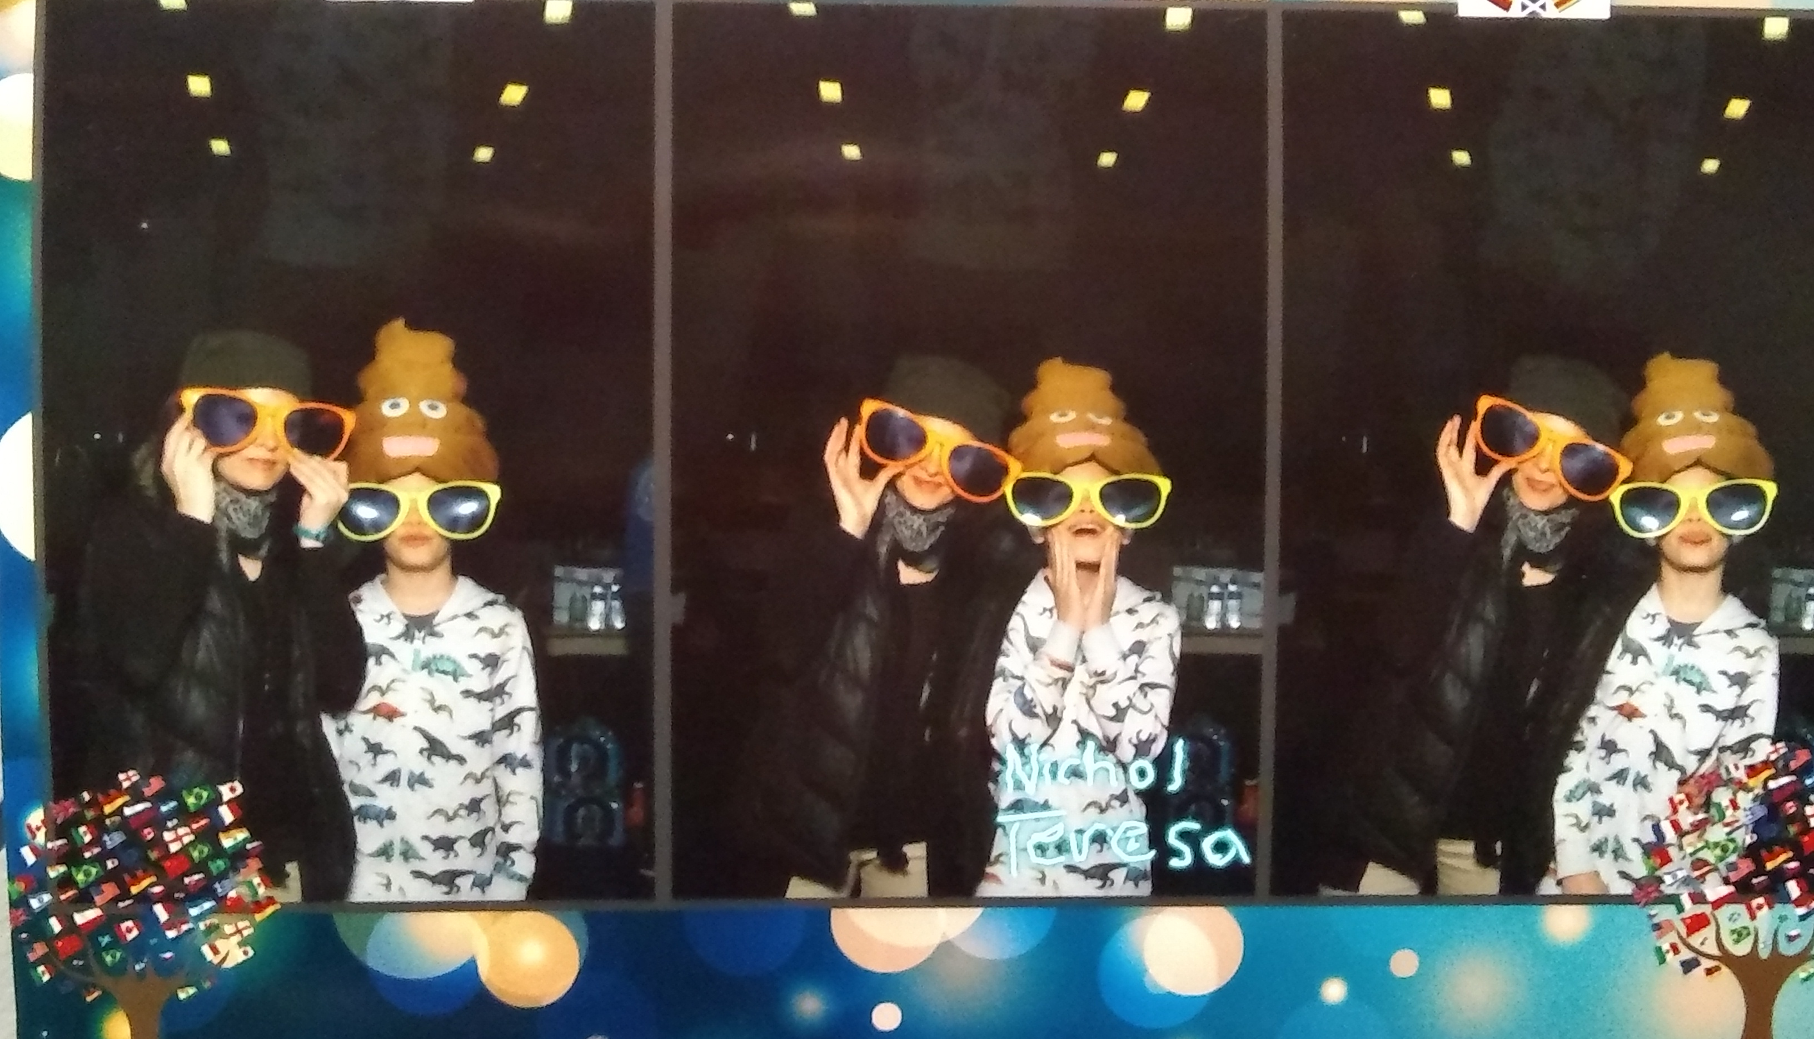
WHO WE ARE
Déborah L .González
Director of Community Bridges
Chair of HACE
Academic Advisor
Professor-History of Puerto Rico; Spanish
Member: PACE, Diversity Caucus, LAHA Board of Directors
Mother of Adria and Sophia
Teresa Varriale González
Professor-Sociology; Anthropology; History of Puerto Rico
Academic Advisor
Member: E3, Diversity Caucus, Liberal Arts, Hector Reyes Advisory Committee
Mother of Nicholas Eduardo

Slide 4
Culturally and Linguistically Responsive Pedagogy (CLRP): Institutional, Personal, and Instructional dimension.
CLRP in Theory
Gay (2002) defines culturally responsive teaching as using the cultural characteristics, experiences, and perspectives of ethnically diverse students as conduits for teaching them more effectively.
Student Motivation: Gay believes that when instruction is personally relevant, there is a higher interest appeal and material is learned more thoroughly.
CLRP in Practice : Teaching, Mentoring, Advising
Gay (2000) describes four necessary components for the practice of culturally relevant pedagogy: caring, communication, curriculum, and instruction.
Villegas (1991) identifies five cultural criteria that teachers should strive to acquire in order to instruct effectively in a multicultural society:
Respect of Cultural Differences
Know the students’ Cultural Resources
Implement an Enriched Curriculum for all students
Link course content to the students’ Cultural Background
Be aware of Cultural Differences

Slide 5
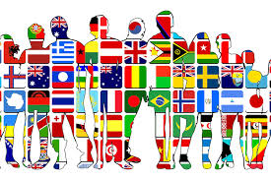
Culturally and linguistically responsive pedagogy (CLRP)
Making learning more inclusive and effective for culturally and linguistically diverse students attending the community college
(Ladson-Billings, 2014; Nieto, 2010; Villegas & Lucas, 2002).
Instructor/Mentor as a Facilitator
CLRP
Bringing Student Culture into the Classroom or meeting setting
Understanding Student personal and cultural Background
Bringing Student Language into the College or meeting setting

Slide 6
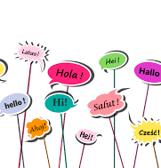
WHAT IS TRANSLANGUAGING?
Approach to language pedagogy that affirms and leverages students’ diverse and dynamic language practices (García & li Wei, 2014; García et al., 2017).
Use of students’ linguistic and cultural repertoire to meet communicative and academic needs in English and other languages (García ,2009; 2 018).
Translanguaging validates multilingualism and multiculturalism as assets by drawing on the students’ diverse linguistic and cultural resources to support the academic and emotional needs of students(García, 2009; Hurst & Mona, 2017; Kleyn & García, 2019).

Slide 7
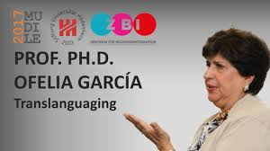
WHO CAN BENEFIT FROM TRANSLANGUAGING?
Beyond the academic and linguistic benefits, translanguaging is an asset-based approach, as well as an important way to validate who students are and what they bring to the college, including their languages and cultures.
Due to the large and increasing number of English Learners (EL), multilingual speakers and multicultural students in our college, we consider translanguaging as a key tool to promote collaboration and actively engage students in their learning processes and college life.
Translanguaging pedagogies create an opportunity for instructors and mentors to build a dynamic learning environment to promote student interaction and inclusiveness (García , 2018; Hamman, 2018).

Slide 8
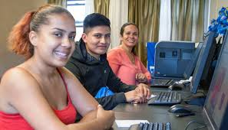
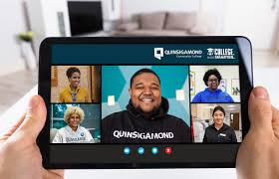
Let’s GET TO KNOW OUR STUDENTS.
Create a classroom and college environment that celebrates students’ own languages and cultures
Cultural Awareness
Become familiar with students’ cultural heritage and norms to foster mutual understanding.
Learn about students’ backgrounds, cultures, and customs.
Communication
Build a trusting relationship with students through meaningful dialogue and open-minded conversations.
Confidence
Build students confidence by helping them feel comfortable, proud of themselves and their accomplishments.
Passion
Inspire students by showing them love and commitment for teaching/mentoring, advising and joy for spending time with them. When students see their instructor’s/mentor’s passion, they have a reason to be engaged and motivated.

Slide 9
EQUITY AND EXCELLENCE EXPERIENCE
E³ is a yearlong collaborative venture into equity and inclusive excellence supported by the Center for Academic Excellence and by Student Success Funding.
Use of reality pedagogy (Emdin, 2016) to innovate our teaching and learning in classrooms and beyond.
Student success means more than completing a program or meeting a minimum GPA. Students learn beyond the classroom and beyond program outcomes.
“When students see themselves in the curriculum, they develop stronger relationships with both their teachers and peers—and with the content as well” (Emdin 2016).

Slide 10
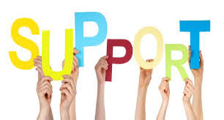
So what? What should we do?
Cultural competence (Pratt-Johnson (2006) is a key element for developing culturally sustaining initiatives and pedagogies (Paris, 2012) and gain a holistic understanding of students’ background knowledge and abilities.
Create initiatives to help students develop cultural awareness and encourage them to share their cultural and linguistic resources(Gay, 2000; Solorza et al., 2019).

Slide 11
Steps to become a CLR Mentor/Instructor
Assess your own behavior. Practice Cultural Sensitivity
If your students’ cultures differ from yours, you need to be sensitive to the differences in attitudes and customs to build relationships with your students. Make sure you’re being sensitive to everyone’s culture, beliefs, language concerns, and non-verbal communication.
2. Get to know your students.
Learning about the different cultural/linguistic backgrounds of the students. Research, either online or by talking to your colleagues. Give students a chance to speak about themselves and their culture.
3. Build Trust
Listening is the key to building trust with students . Getting to know students and their families’ cultures and traditions is extremely valuable when building trust with students.
4. Maintain Consistent Communication
Aside from getting to know your students, you should also continue to maintain ongoing communication throughout the semester or year. Be open to do communicate exchanges in different languages; make use of technology accordingly.
5. Make your classroom or mentorship sessions a judgment-free zone. Changing the paradigm of the English only approach.
Encouraging students to voice their opinions and questions about what is happening in the world around them is one of the best ways to help them understand and overcome some of their preconceived notions.
6 Adapt your teaching or mentoring practices. Incorporate Diversity in the Lesson Plan or Mentoring sessions.
Assess your current communicative practices and modify your style and content to consider all students’ backgrounds. Choose content that reflects the different cultures of your students in your lessons and set the stage. Plan activities to celebrate diverse cultural practices represented.
7. Give Students Freedom and Flexibility
Act as a facilitator and encourage conversation and healthy debate between diverse opinions.

Slide 12
Tips for mentors/instructors
Incorporate the students’ native language into the classroom, mentoring, and advising sessions
Provide opportunities for students to use their native language
Allow students to speak their language to help lower proficiency peers
Use surveys to find out about my students’ cultural and linguistic background
Spend time outside learning about the cultures and languages of your students/mentees
Learn words or phrases in the students’ native language for your greetings or throughout the sessions
Involve students in activities to share their language and culture with the group( food, music, dance, sport, and traditions)
Ask for student input when planning lessons and activities
Relate content and communicative strategies to the linguistic and cultural background of your students

Slide 13
QUESTIONS FOR INSTRUCTORS/MENTORS
What is your opinion on the use of students’ native language and culture in the community college environment?
Do you incorporate the language and culture of your students in your lessons or when approaching students for mentoring/advising?
What strategies do you use to get to know your students’ linguistic and cultural background?

Slide 14
QUESTIONS FOR STUDENTS
What is your opinion on the use of your native language and culture in the community college environment?
Would you like your instructor or mentor to incorporate your language and culture in the lessons or during mentoring/advising sessions?
What suggestions do you have to help us getting to know your linguistic and cultural background?

Slide 15
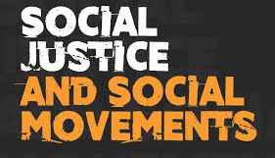
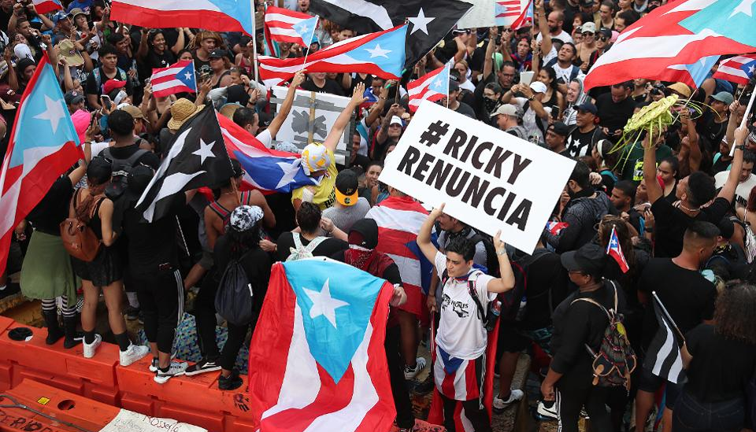
RAISE YOUR VOICE PROJECT
Individuals do have power to speak up and to speak out
HST 133-HISTORY OF PUERTO RICO
SOC211- DYNAMICS OF RACIAL AND ETHNIC RELATIONS
USE OF TECHNOLOGY TO COMMUNICATE WITH THE STUDENTS SUCH AS GOOGLE TRANSLATE, AND WHATSAPP, ZOOM SUBTITLES, ETC.

Slide 16
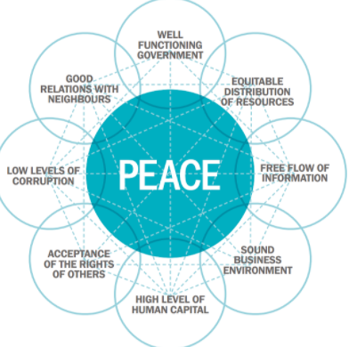
The Pillars of Peace is a holistic framework of factors that make a country more peaceful.
Investigate the history of Puerto Rican social movements and write a brief summary.
Use the Institute for Economic and Peace Pillars of Peace to measure peace in Puerto Rico
Describe the impact of technology to activism, protest and dissent movements in Puerto Rico?
Research biography, social media, history, newspaper articles and documentaries to generate interview questions for Puerto Rico’s governor

Slide 17
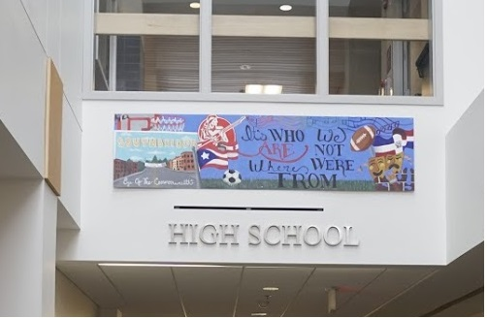
SOUTHBRIDGE CAMPUS. “It’s WHO We ARE /NOT Where WE’RE FROM”

Slide 18
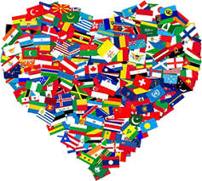
Cultural Appreciation Groups QCC MULTICULTURAL CLUB
Join us to explore cultures and cement the bonds of friendship amongst students.
We know that mentoring and support from the college equates to student success, this includes clubs and organizations which make them feel "part" of that college community, even if we can't meet in person.
The mission of the Multicultural Club is to promote cultural awareness and understanding, as well as to connect students with the broader community. We strive to increase opportunities for students to learn, celebrate, and appreciate the beauty of all cultures represented on campus and around the world. Our goal is to offer students a virtual place to meet new friends and have fun together. The club promotes events and themes designed to learn and celebrate diverse cultures and to enhance the students’ college experience.

Slide 19
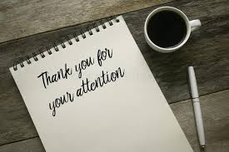
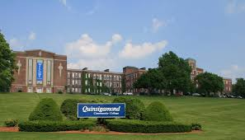
QUESTIONS?
THANK YOU AND ENJOY THE REST OF THE DAY

Slide 20
References
Emdin, C. (2016) For White Folks Who Teach in the Hood … and the Rest of Y'all Too: Reality Pedagogy and Urban Education .Beacon Press, 2016.
García, O. (2009). Education, multilingualism and translanguaging in the 21st century. In A. Mohanty, M. Panda, R. Phillipson, & T. Skutnabb-Kangas (Eds), Multilingual education for social justice: Globalising the local (pp. 128–145). Orient Blackswan.
García, O. (2018). Translanguaging, Pedagogy and Creativity. https://ofeliagarciadotorg.files.wordpress.com/2018/12/Garcia-Translanguaging-pedagogy-and-creativity.pdf
García, O., & Li Wei. (2014). Translanguaging: Language, bilingualism and education. Palgrave Macmillan.
García, O., Johnson, S., & Seltzer, K. (2017). The translanguaging classroom. Leveraging student bilingualism for learning. Caslon.
Gay, G. (2000). Culturally responsive teaching: Theory, research and practice. Teachers College Press.
Gay, G. (2002). Preparing for culturally responsive teaching. Journal of Teacher Education, 53 (2), 106-116. doi: 10.1177/0022487102053002003
Hamman, L. (2018). “Translanguaging and Positioning in Two-Way Dual Language Classrooms: A case for criticality.” Language and Education, 32(1), 21–42.
Ladson-Billings, G. (2014). Culturally Relevant Pedagogy 2.0: a.k.a. the Remix. Harvard Educational Review, 84(1), 74–84.
https://doiorg.umasslowell.idm.oclc.org/10.17763/haer.84.1.p2rj131485484751
Nieto, S. (2010). Language, Culture, and Teaching: Critical Perspectives (2nd Edition). Routledge. Taylor and Francis Group.
Paris, D. (2012). Culturally Sustaining Pedagogy: A Needed Change in Stance, Terminology, and Practice. Educational Researcher, 41(3), 93-97. https://doi.org/10.3102/0013189X12441244
Pratt-Johnson (2006). Communicating Cross-Culturally: What Teachers Should Know. The Internet TESL Journal, 12(2). http://iteslj.org/Articles/Pratt-Johnson-CrossCultural.html
Solorza, C.R., Aponte, G.Y., Leverenz, T., Becker, T., & Frias, B. (2019). Translanguaging in Dual Language Bilingual Education: A Blueprint for Planning Units of Study. The Graduate Center, The City University of New York. https://www.cuny-nysieb.org/wp-content/uploads/2019/09/Translanguaging-in-Dual-Language-Bilingual-Education-A-Blueprint-for-Planning-Units-of-Study-RSVD.pdf
Villegas, A.M. (1991). Culturally responsive pedagogy for the 1990s and beyond (Trends and Issues Paper No. 6) Washington DC: ERIC Clearinghouse on Teacher Education
Villegas, A. M., & Lucas, T. (2002). Preparing culturally responsive teachers: rethinking the curriculum. Journal of Teacher Education, 1, 20.

