Slide 1
INFORMATIONAL INTERVIEWS

Slide 2
agenda
Introduction
Prior to the Interview
Request the Interview
Prepare the Questions
Conduct the Interview
Moving Forward

Slide 3
introduction
What are informational interviews?
An informal conversation lasting 20-30 minutes with a person working in a job field that interests you.
Purpose:
To gather information, explore career paths, and make connections.

Slide 4
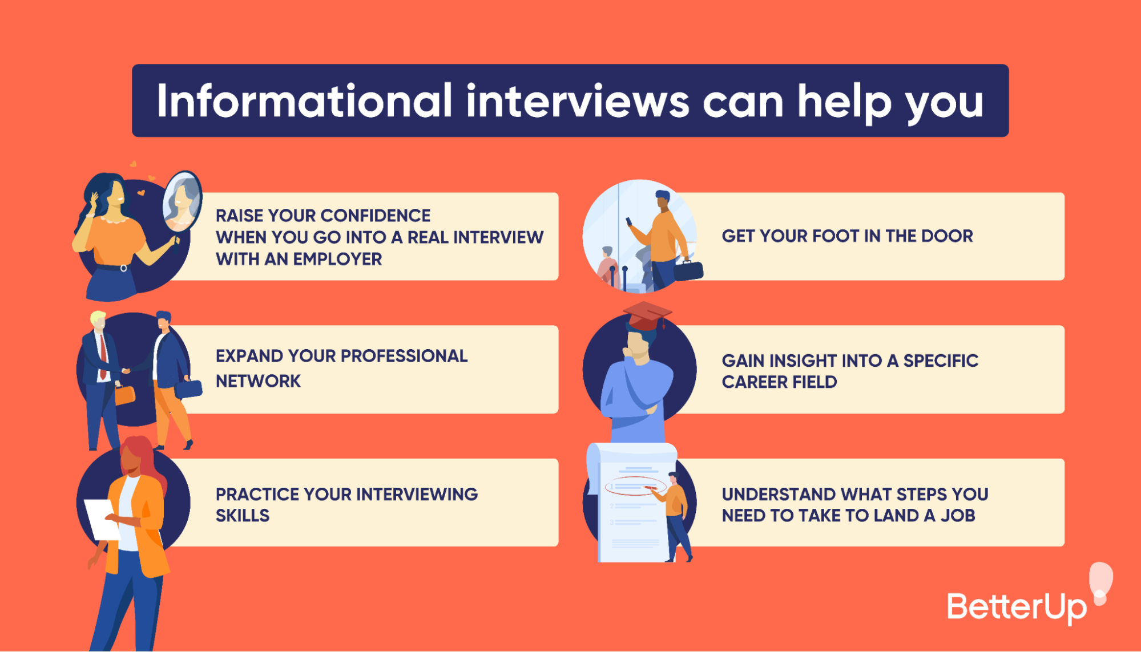
Prior to the interview
  Identify professionals with jobs that interest you
  Research the person’s job title, career field, and company information
  Identify the goals of conducting the interview

Slide 5
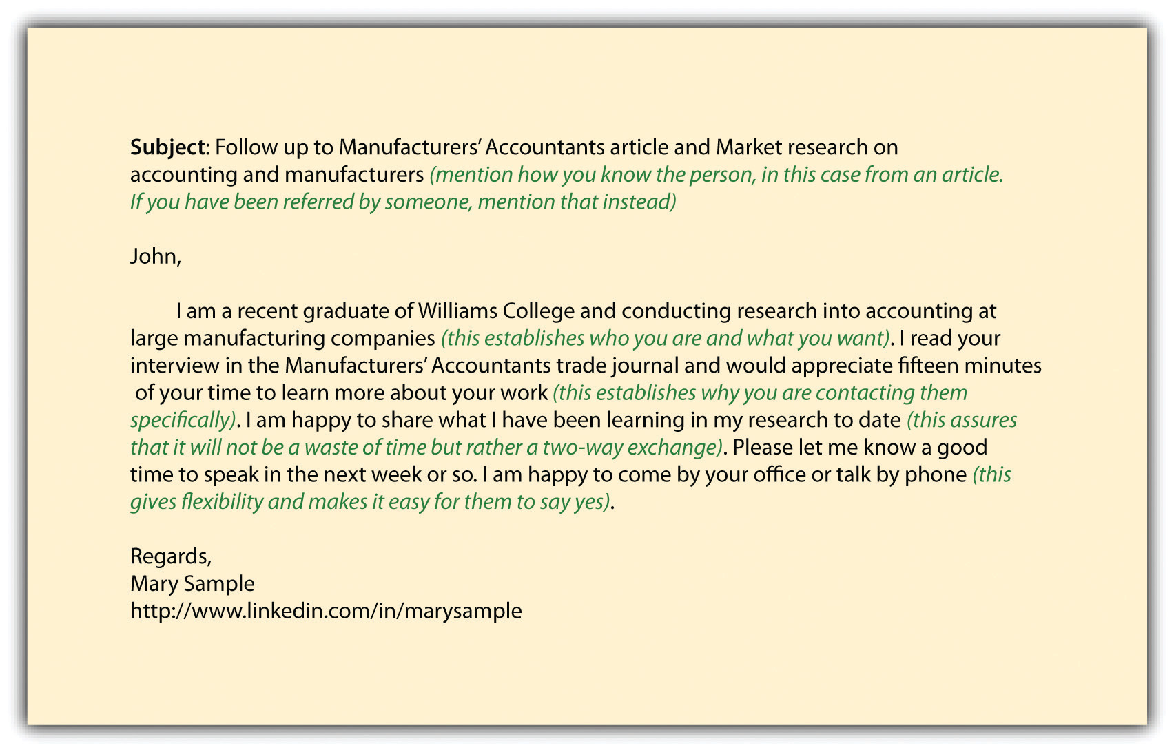
Request the interview
  Craft a professional email or phone call requesting the informational interview
  Briefly introduce yourself and express your interest in their career plus anything you have in common
  Request the interview 1-4 weeks out
  Set a location for the interview

Slide 6
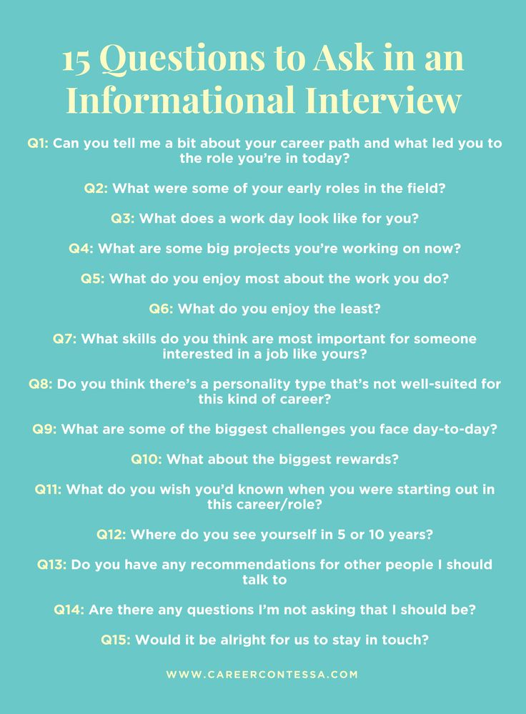
Prepare the questions
  Do not waste their time – ask questions based on your prior research that you could not find the answers to online
  Ask questions about their career journey, challenges, advice for newcomers, and industry trends
  Prepare 6 to 8 open-ended questions that cannot be answered with a simple yes or no
  Follow up in 2 weeks if you have not received a reply

Slide 7

Conduct the interview
  Treat the interview like any other – be professional, courteous, and on time
  Actively listen and take notes
  Send a thank you email or note within 24 hours of the completion of the interview

Slide 8

moving forward
  Regularly conduct informational interviews to gain information and make connections in your career
  Periodically follow up with your contacts to keep the connection alive by updating them on your progress
  Reflect on key takeaways and the skills and experiences you will need to build upon your strengths

Slide 9

Questions?

Slide 10

Thank you!
QCC Mentoring
Director: Kalan Lewis
mentoring@qcc.mass.edu
508-854-7409

